Slide 1
Impact of Fragmentation on ATM System Performance
Prof. Dr.-Ing. habil. Hartmut Fricke
Institute of Logistics and Aviation
Research Workshop on Fragmentation in Air Traffic and its Impact on ATM Performance
Budapest, May 2019

Slide 2
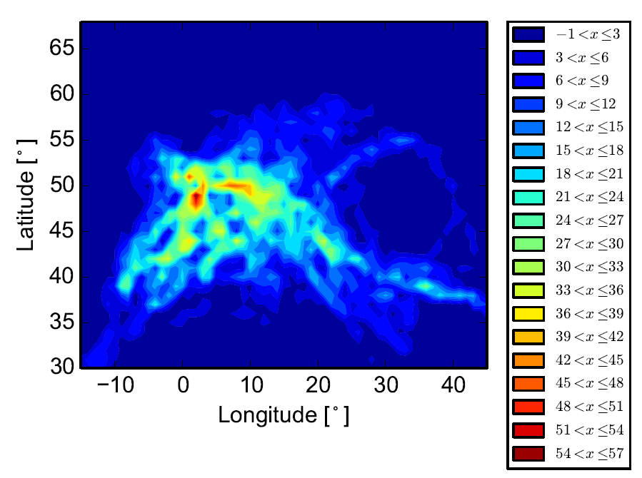
Agenda
The Rationale of Fragmentation
Current Performance according to PRR
Types of fragmentation – Challenges from
the flow – 4D Business Trajectories
Dynamically Improved Airspace Design
Expectations for the Workshop
Airspace capacity in an European optimized air traffic scenario (8,800 flights between 12 a.m. and 1 p.m.)
Source: J. Rosenow, H. Fricke, T. Luchkova and M. Schultz: Impact of optimised trajectories on air traffic flow management, The Aeronautical Journal, 2019
Notes:
Die Einheit sind Anzahl der Luftfahrzeuge in einer Luftsäule mit den Maßen von 1 ° mal 1 ° (Longitude mal Latitude) über alle Höhenlevel.

Slide 3
Agenda
The Rationale of Fragmentation
Current Performance according to PRR
Types of fragmentation – Challenges from
the flow – 4D Business Trajectories
Dynamically Improved Airspace Design
Expectations for the Workshop
Airspace capacity in an European optimized air traffic scenario (8,800 flights between 12 a.m. and 1 p.m.)
Source: J. Rosenow, H. Fricke, T. Luchkova and M. Schultz: Impact of optimised trajectories on air traffic flow management, The Aeronautical Journal, 2019

Slide 4
Liberalization and Fragmentation
Until 1987: National markets within the EU were protected (and subsequently fragmented)
Three liberalization packages in aviation industry (1987- 1992) changed the situation
In 1990s: Significant deterioration of on-time performance in the EU
  Suspected reason: Underperformance of the ATM systems
  Considerable traffic increase versus ageing technologies and systems
Furthermore: Fragmentation of European skies
  Airspaces have been managed in accordance with national boundaries
  Boundaries, and partly sectors, were not determined based on the dynamic traffic demand/flows, but mainly according to national territories
  In 2003: More than 60 Area Control Centers in Europe
  Subsequently: Different systems, tools and procedures
Notes:
ATM in Europe is provided by 27 separate ANSPs involving a wide range disparity of sizes and cost structures
Today, 650 sectors in Europe (FABEC-All About Performance)

Slide 5
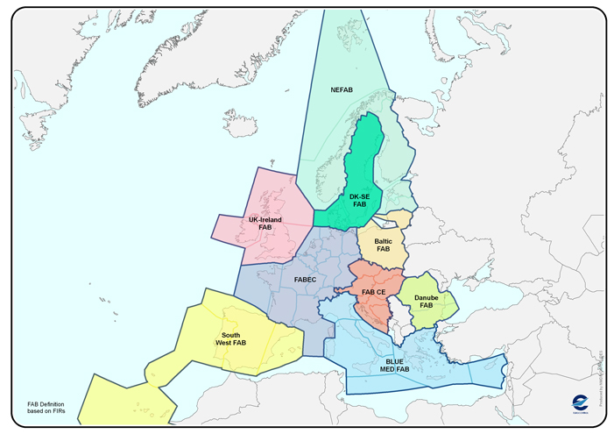
Defragmenting European Skies
EU initiated regulation packages in order to
  restructure European airspace
  enlarge airspace capacity
  increase the overall efficiency of the ATM system
  enhance safety standards
Features (sample)
  Setting-up of cross-border functional airspace blocks (FABs)
  Implementation of an European Upper Flight Information Region (UIR)
  Harmonization of Flight level division level and of airspace classification, common principles and criteria for route & sector design
  Flexible Use of Airspace (FUA)
  Rules for Air Traffic Flow Management
(source EUROCONTROL)
Notes:
The organization of FABs allways has a State Point of view and an ANSP Point of view
SESAR‘s Airspace Architecture Study (AAS) entitled: A proposal for the future architecture of the European airspace aims to
• Launch an airspace re-configuration programme supported by an operational excellence programme to achieve quick wins;
• Realise the de-fragmentation of European skies through virtualisation and the free flow of data among trusted users;
• Create a legal and financial framework that rewards early movers.

Slide 6

Fragment(ation) – A part of the whole
In any technical system which does not run fully automated , humans act as supervisor, decision maker or steering and control element.
In ATM, we deal with a socio-technical system, which is also safety critical.
Humans only posses limited cognitive resources, so task and work load must be well under control to operate the system safely.
So the system must hold a unique area of responsibility. „Area“ is a manifold, typically considered as 3D element
Input Parameters: number of ATCOs on duty, number of expected controlled flight hours (demand)
Output Parameters: number of effectively controlled flight hours (throughput). Level of Service metrics (from delay to separation infringement counts). Performance P (to priotize and sequence) over time t to control flight n.
Efficiency then as rate of demand (at costs willing to pay) / throughput (at effective prices)
Set-Up of the area of responsibility = Sector (again starting from the 3 D perspective)
$$P_{P\&S}=\frac{Q_{P\&S}}{t_{n}}.$$

Slide 7
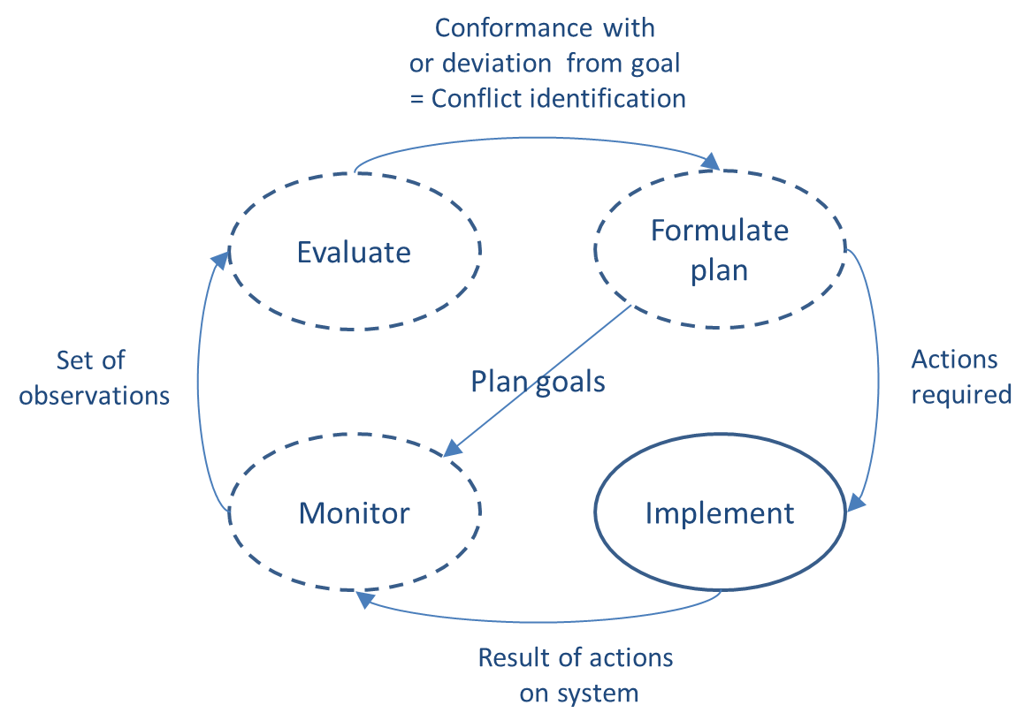
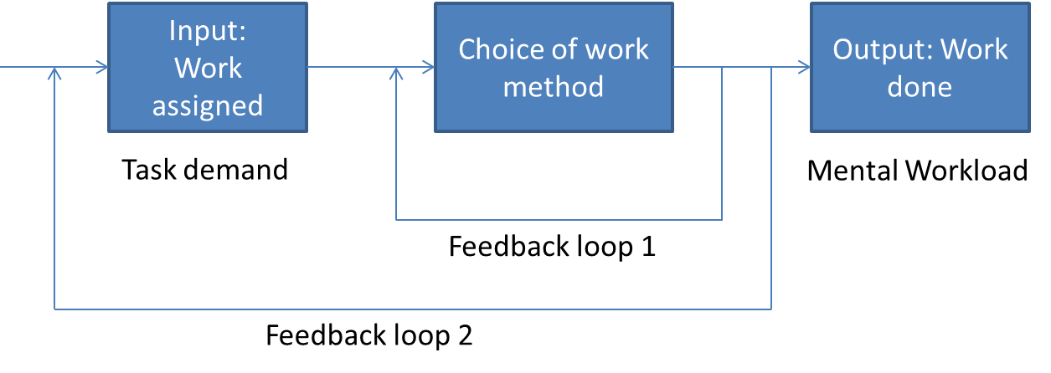
The right “fragment” – Correlation between Workload and traffic (1)
Closed-loop model of ATCO
mental workload (Sperandio 1971)
Mental and Physical Process Required in Air Traffic Control (Pawlak, 1996)

Slide 8
The right “fragment” – Correlation between Workload and traffic (2)
Airspace
demands
Skill
Interface
demands
Strategy
TASKLOAD
WORKLOAD
Other task
demands
Experience
Etc.
Etc.
System factors
Operator factors
Model of ATC workload (Hilburn & Jorna 2001)

Slide 9
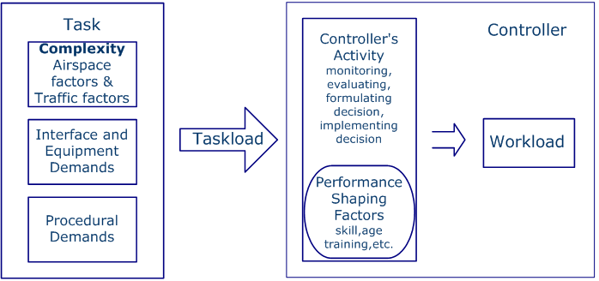
The right “fragment” – Correlation between Workload and traffic (3)
Simplified scheme of the relationship between ATC complexity and workload,
adapted from Hilburn (2004)

Slide 10
What drives “Complexity”?
 |  | Complexity Factors | Further References
1 | Aircraft density | number of aircraft | Chatterji & Sridhar (2001); Kopardekar & Magyarits (2003); Sridhar, Sheth & Grabbe (1998); Kopardekar (2000)
2 |  | density indicator | Delahaye & Puechmorel (2000) ; Chatton (2001) ; Gianazza & Guittet (2006)
3 | Flight attributes | number of climbing aircraft | Chatterji & Sridhar(2001); Kopardekar & Magyarits (2003); Kopardekar et al. (2009)
4 |  | number of descending aircraft | Chatterji & Sridhar (2001); Kopardekar & Magyarits (2003); Kopardekar et al. (2009)
5 |  | number of aircraft with heading change >15˚ | Laudeman et al. (1998); Kopardekar & Magyarits (2003); Kopardekar et al. (2009)
6 |  | number of aircraft with the speed change >10 knots | Laudeman et al. (1998); Kopardekar & Magyarits (2003); Kopardekar et al. (2009)
7 | Aircraft conflicts | number of a/c with lat. distance between 0-25nm and vert. separation < 2000ft above 29000ft | Laudeman et al. (1998) ; Kopardekar & Magyarits (2003) ; Kopardekar et al. (2009)
8-10 |  | horizontal proximity measure 1,2,3 | Chatterji & Sridhar (2001) ; Kopardekar & Magyarits (2003) ; Kopardekar (2000) ; Martin et al. (2006) ; Gianazza & Guittet (2006)
11-13 |  | vertical proximity measure 1,2,3 | Chatterji & Sridhar (2001) ; Kopardekar & Magyarits (2003) ; Kopardekar (2000) ; Martin et al. (2006) ; Gianazza & Guittet (2006)
14 |  | time-to-go to conflict measure | Chatterji & Sridhar (2001) ; Kopardekar & Magyarits (2003) ; Kopardekar (2000) ; Martin et al. (2006)
15 |  | divergence between pairs of aircraft | Delahaye & Puechmorel (2000) ; Chatton (2001) ; Gianazza & Guittet (2006)
16 |  | convergence between pairs of aircraft | Delahaye & Puechmorel (2000) ; Chatton (2001) ; Gianazza & Guittet (2006)
17,18 |  | sensitivity indicator (a/c converging; a/c diverging) | Delahaye & Puechmorel (2000) ; Chatton (2001) ; Gianazza & Guittet (2006)
19,20 |  | insensitivity indicator (a/c converging; a/c diverging) | Delahaye & Puechmorel (2000) ; Chatton (2001) ; Gianazza & Guittet (2006)
21 | Traffic disorder | variance of ground speed | Chatterji & Sridhar (2001) ; Kopardekar & Magyarits (2003) ; Gianazza & Guittet (2006) ; Martin et al. (2006)
22 |  | ratio of standard deviation of speed to average speed | Chatterji & Sridhar (2001) ; Kopardekar & Magyarits (2003) ; Gianazza & Guittet (2006) ; Martin et al. (2006)
23 |  | variability in headings (track_disorder) | Delahaye & Puechmorel (2000) ; Chatton (2001) ; Gianazza & Guittet (2006)
24 |  | variability in speed (speed_disorder) | Delahaye & Puechmorel (2000) ; Chatton (2001) ; Gianazza & Guittet (2006)
4 Factor groups:
1. Aircraft density
2. Flight attributes of each
aircraft
3. Aircraft conflicts
4. Traffic disorder
Consisting of 24 parameters as
identified
in own experiments
(and literature):
Consolidated factors driving complexity,
adapted from Djokic, Fricke (2016)
Collected Complexity Parameters, Djokic, Fricke 2016

Slide 11
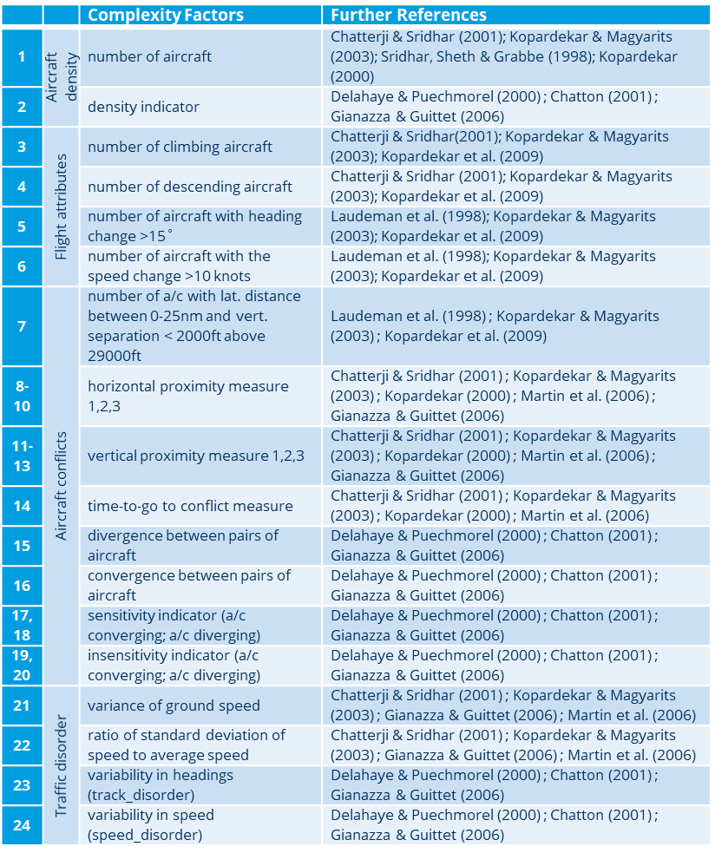
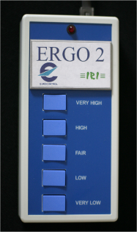
Determine Workload out of given Complexity using RTS
Using Workload Models based on Instantaneous self-assessment (ISA) or physiological measurement.
Principal Component Analysis (PCA)
C1= b 11(X) + b12(X 2) + ... b1p(X)
ISA DEFINITION
Rating | Self Assessment of Workload
5 | Very High | A very high workload, any additional task would push you into overload.
4 | High | High workload level that leaves very little spare capacity.
3 | Comfortable | Enough work for the job to be interesting and challenging. Some spare capacity.
2 | Relaxed | Not quite enough traffic to fully occupy you.
1 | Under-utilised | You have very little to do and few, if any, aircraft on the frequency.
ISA - Instantanous
Self Assessment
Eurocontrol CRDS: ISA workload assessment tool

Slide 12
Determine Workload out of Complexity parameters
Complexity factors | Component
 | 1 | 2 | 3 | 4 | 5 | 6
variance of ground speed | 0.908
ratio of std of speed to average speed | 0.875
convergence between pairs of aircraft | 0.775
divergence between pairs of aircraft | 0.743
number of aircraft |  | 0.794
number of climbing aircraft |  | 0.707
variability in headings (track disorder) |  | -0.705
number of aircraft with heading change greater than 15˚ |  | 0.482
number of descending aircraft |  |  | 0.798
number of a/c with the speed change greater than 10kt |  |  | 0.740
vertical proximity measure 1 |  |  | -0.562
number of aircraft with lateral distance between 0-25nm and vertical separation less than 2000ft above 29000ft |  |  | 0.547
horizontal proximity measure 1 |  |  |  | 0.898
density indicator |  |  |  | 0.836
sensitivity indicator (a/c diverging) |  |  |  |  | 0.778
sensitivity indicator (a/c converging) |  |  |  |  | 0.746
time-to-go to conflict measure |  |  |  |  | 0.619
insensitivity indicator (a/c converging) |  |  |  |  |  | 0.717
insensitivity indicator (a/c diverging) |  |  |  |  |  | 0.662
Searching for analytical representations of ISA – Ratings (workload suffered) and relevant complexity factors as identified through PCA to predict ISA:
 | Alpha | Std. Error | Beta | t | Sig.
ground speed variance and divergence/convergence | 0.066 | .020 | .090 | 3.298 | p< 0.05
aircraft count | 0.107 | .021 | .146 | 5.161 | p< 0.001
aircraft vertical transitioning | 0.089 | .020 | .121 | 4.423 | p< 0.001
horizontal proximity | -0.092 | .020 | -.125 | -4.584 | p< 0.001
conflict sensitivity | -0.144 | .021 | -.196 | -7.003 | p< 0.001
insensitivity | 0.072 | .020 | .098 | 3.607 | p< 0.001
Frequency Occupancy Time | 0.012 | .003 | .143 | 4.701 | p< 0.001
Average Radio Duration | -0.184 | .033 | -.165 | -5.531 | p< 0.001
Multiple regression analysis
to predict ISA values
(6 PCA components
plus 2 activity measures)
Y’=A+B1X1+B2X2+…+BkXk
Results of Principal Component Analyses, Djokic, Fricke 2016
Notes:
And the final axis reflects the sensitivity of the conflict duration with the speed and heading modifications. Delahaye and Puechmorel (2000) argue “that a convergent situation with a high sensitivity is better than a convergent situation with a low sensitivity, the induced complexity will be higher in the later than in the former.” Therefore, in order to have a homogeneous coordinate system, the final axis represents so-called insensitivity.

Slide 13
1st Interim Conclusion
Relevant factors driving complexity – need for fragmentation
1. ground speed variance and divergence/convergence
2. aircraft count
3. aircraft vertical transitioning
4. horizontal proximity
5. conflict sensitivity (of a conflict duration if speed and/or heading modifications are being applied)
Non-surprisingly – all of these factors are quantitatively fragment size depending, so splitting airspace seems intuitive to keep workload at reasonable level.

Slide 14
Agenda
The Rationale of Fragmentation
Current Performance according to PRR
Types of fragmentation – Challenges from
the flow – 4D Business Trajectories
Dynamically Improved Airspace Design
Expectations for the Workshop
Airspace capacity in an European optimized air traffic scenario (8,800 flights between 12 a.m. and 1 p.m.)
Source: J. Rosenow, H. Fricke, T. Luchkova and M. Schultz: Impact of optimised trajectories on air traffic flow management, The Aeronautical Journal, 2019

Slide 15
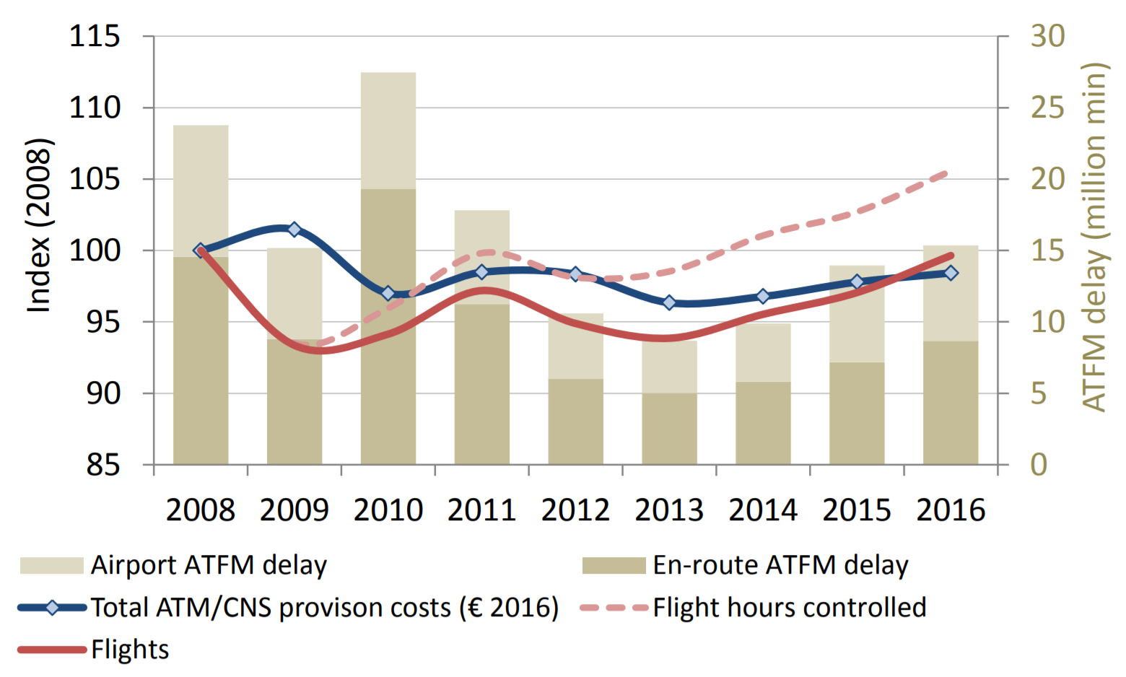
Economic Efficiency – Decade perspective
PRR (2017)
evolution of ATM/CNS provision costs (expressed in
€₂₀₀₈) together with the evolution of ATFM delay and
controlled flight hours for the EUROCONTROL area between 2008 and 2016.
number of flights served were comparable in 2016
(-0.4% vs. 2008), the controlled flight hours were
+5.6% above the level of 2008
significant improvements at system level since 2008: en-route ATFM delays in 2016 were 40% lower and airport ATFM delays were 27% lower compared to 2008

Slide 16
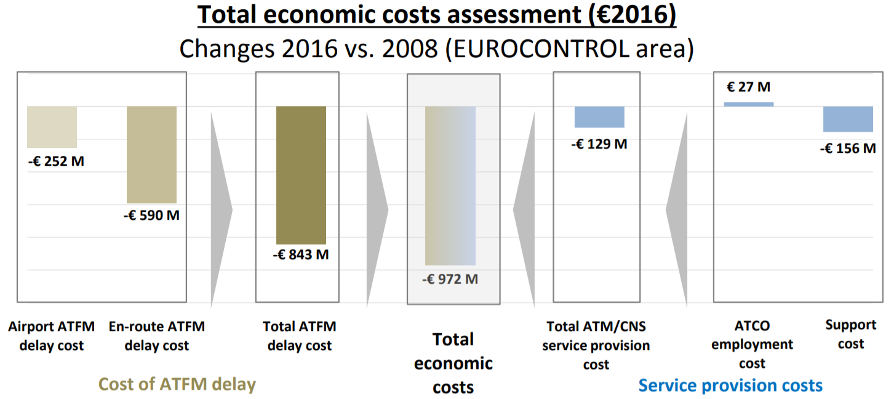
Economic costs - high level comparison – Decade perspective
PRR (2017)
Notes:
At the same time, ATCO hour productivity increased (+10.1% vs. 2008) and support cost per flight hour decreased by -7.9% compared to 2008, leading to an overall reduction of ATM/CNS unit provision costs of -6.8% vs. 2008. Although the ATM system improved compared to 2008, there is clearly scope for further improvement. With the focus mainly on cost savings over the past years, the system benefited from the depressed traffic levels following the start of the economic crisis in 2008. However, with traffic growing again it is vital to work proactively on capacity deployment in order to be able to accommodate forecast demand and to avoid exponential increases of delay costs to airspace users.

Slide 17
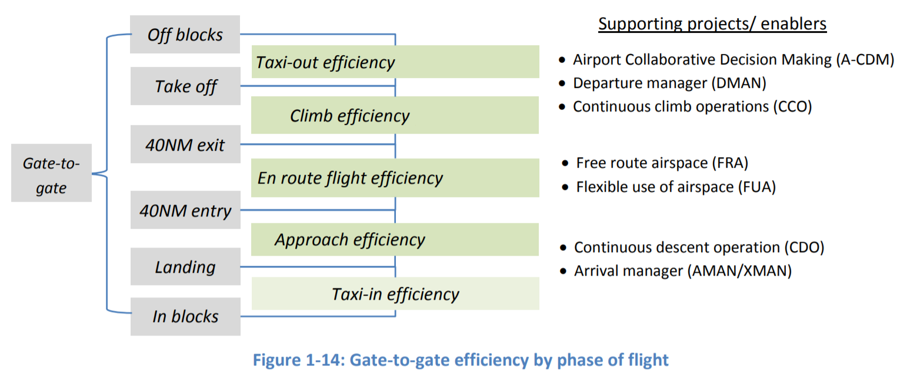
Operational efficiency by flight phase – Current perspective
PRR (2017)
En-Route ANS Performance 2017 (vs. 2016)
IFR flights controlled 10.6 Mio (+4.3%)
En-route ATFM delayed flights 5.3% (+0.6% pt.)
Average en-route ATFM delay per flight 0.88 min (+0.03 min)
Total en-route ATFM delay (min.) 9.3 Mio (+7.1%)
Av. horizontal en-route efficiency (flight plan) 95.6% (+0.2% pt.)

Slide 18
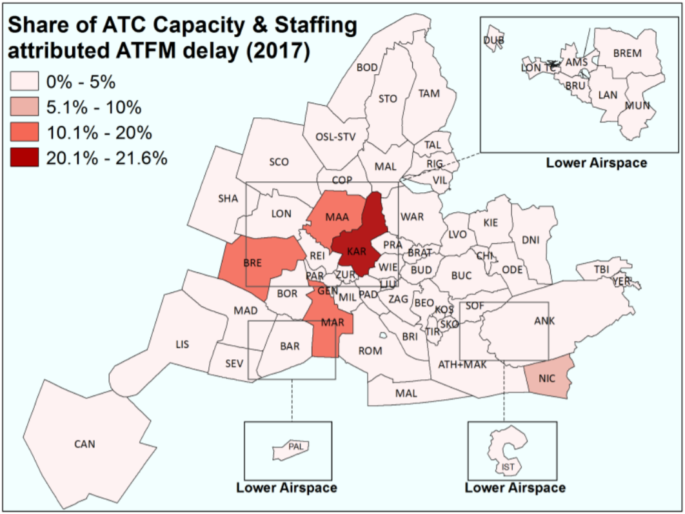
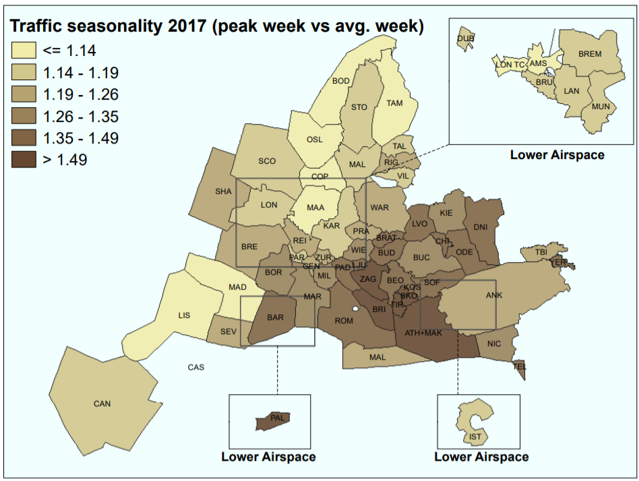
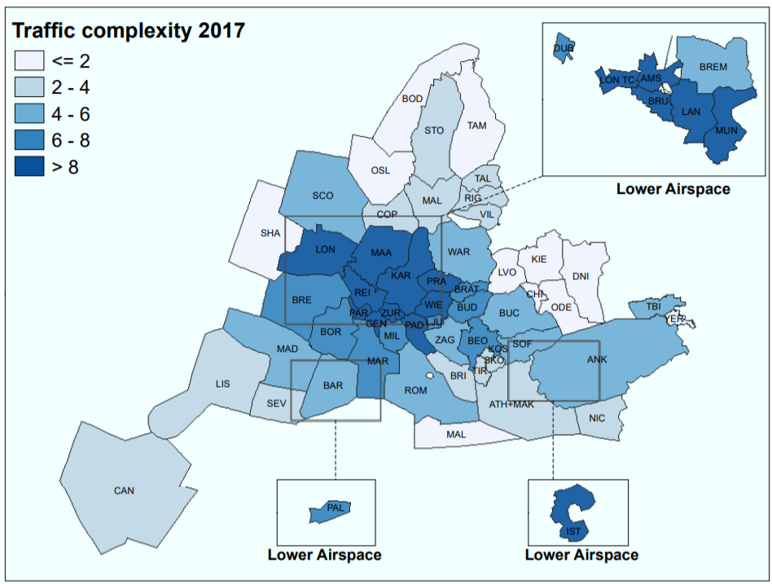
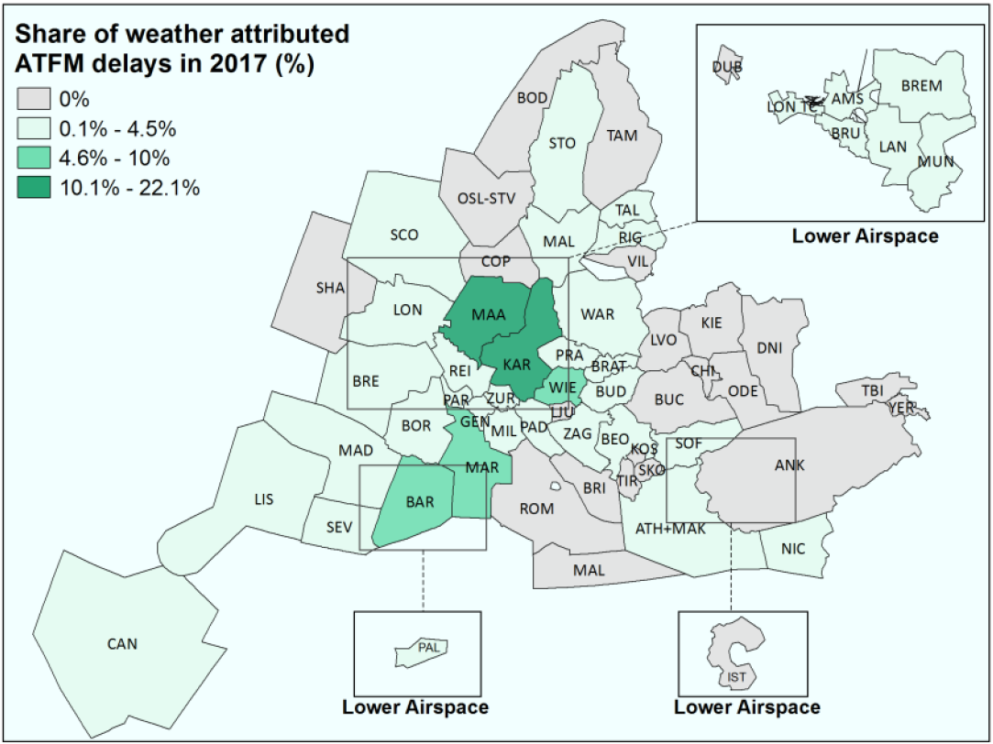
Traffic structure and delay
PRR (2017)
Severe heteorogenity regardless selected metric –
there is probably no „optimum fragmentation“
Notes:
Traffic seasonality
ANS performance needs to consider air traffic variability and complexity. Providing sufficient capacity to satisfy demand in the future involves a number of factors including, inter alia, the order of magnitude of the expected traffic volume changes, the lead time before the change occurs, the level of predictability, and the level of flexibility in capacity deployment. Figure 3-3 provides an indication of the level of variability between peak and average weeks in each of the ACCs in 2017. Comparatively high levels can be observed in ACCs affected by holiday traffic peaks in the summer. In some ACCs, traffic in the peak week is more than 50% higher than in the average week.
Traffic complexity
The various ANSPs show a contrasted picture in terms of complexity with Skyguide showing the highest level, followed by NATS, Maastricht, DFS and Belgocontrol. As can be expected, the highest complexity scores are observed in the European core area with scores notably higher than the EUROCONTROL average. It is important to point out that traffic variability and complexity in this section are shown as weekly or annual averages. The results can differ notably at other granularity levels (daily, hourly, etc.).
Staffing
ATC Capacity & Staffing attributed en-route ATFM delays are concentrated in five ACCs (Karlsruhe, Marseille, Brest, Maastricht, and Nicosia) which together accounted for 62% of all ATC Capacity & Staffing attributed delay in 2017.
The PRC analysed the “ATC Capacity & Staffing” delay category in terms of (i) delay attributed to elementary sectors and (ii) delays attributed to collapsed sectors which, by being collapsed, already limited the available capacity for airspace users.
Weather:
More than two thirds of the weather attributed en-route ATFM delay in 2017 were allocated between DFS (30.4%), DSNA (19.7%) and MUAC (18%). Figure 3-13 shows that the vast majority of the weather-attributed en-route ATFM delays were located in the core area with the highest density of traffic.
As with ATC Capacity & Staffing attributed ATFM delays, the weather attributed delays were concentrated in a few ACCs/UACs. Together, Karlsruhe, Maastricht, Marseille, Wien, and Barcelona accounted for 63% of total weather attributed en-route ATFM delay in 2017.
Sehr geehrter Herr Prof. Fricke,
zu den Delays und deren Allokation: Hier kann es viele Gründe geben. Die Grafik stammt aus dem Performance Review Report 2017, S. 23ff: https://www.eurocontrol.int/sites/default/files/publication/files/prr-2017.pdf
Die ACCs Karlsruhe, Brest, Nicosia, Marseille und MUAC sind dabei für 62% des ATC Capacity & Staffing attributed delay verantwortlich. Hinweis: Dies ist nur ein Teil des Gesamt-delays (u.a. neben wetterbedingten Verspätungen). Leider geht der Bericht nicht tiefer auf die Gründe ein. Es ist m.E. auch noch nicht eindeutig bestimmbar, warum bspw. explizit Karlsruhe so hohe delay Zahlen hat (außer ggf. mit Insiderwissen, was wohl keine ACC veröffentlichen wöllte). Ich würde daher vorschlagen, allgemeine Gründe zu nennen, die dazu beitragen können:
· Verkehrsvolatilität (hier gibt es allerdings noch kein valides Maß) bzw. -schwankungen in Menge und/oder Verteilung
· Geringe Vorhersagbarkeit auf lang- bis kurzfristiger Ebene – hier könnte man auch „provision of directs“ ansprechen.
· Personalstock und Flexibilität in der Personaleinsatzplanung, bspw. um Verkehrs-Peaks oder Krankmeldungen abzufedern (ggf. weitere Idee: Incentives für Überstunden / Teilzeit), Planung/Nutzung von Ressourcen-Puffer.
· Die genutzten Tools und Systeme
· Häufigkeit/Nutzung von TRAs (physisch und zeitlich) durch das Militär – wenngleich ich hier unsicher bin ob dies auf Capacity/Staffing delay einwirkt.
Zu den Metriken: Hier würde ich unterscheiden, welche Fragmentierung adressiert wird. Beispiel strukturell: Ein Airspace-Merging kann als Vergrößerung des Betriebs angesehen werden. Hier sind Skaleneffekte zu erwarten:
· positive, sofern der Output anteilig stärker steigt als der Input
· konstante, sofern Anteil der Outputsteigerung = Anteil der Inputsteigerung
· negative, sofern der Output anteilig geringer steigt als der Input
Bei der ökonomischen Modellierung, bzw. der Methodenwahl, muss zudem berücksichtigt werden, dass eine ANSP multiple Inputs und Outputs hat. Ein Ansatz stellt daher die Data Envelopment Analysis dar, um die Skaleneffekte zu bestimmen. Um zu analysieren, welche (exogenen) Faktoren einen Einfluss auf die Effizienz haben, wird in der Regel noch eine 2nd-stage Regression durchgeführt. Andere Ansätze dann gemäß den Papern, die ich leider nicht kenne (ich glaube die Kollegen aus Bilbao haben einen SFA-Ansatz gewählt).

Slide 19
2nd Interim Conclusion
Need for adopting fragmentation concepts
Fragmentation is a must for safety critical systems, that include the human in tactical control
Workload is considered to be the core metric for a human reliability score, but is time dependent
Workload is significantly driven by complexity, which in turn, relies on the demand
The demand is volatile, currently growing strong – current fragmentation strategies are rather rigid
Up-to-now Fragmentation strategies rely on typical (long-term statistical) input values
Current fragmentation strategies worked well over the last decade on average but cannot accommodate further traffic growth efficiently, being subject of optimization itself

Slide 20
Agenda
The Rationale of Fragmentation
Current Performance according to PRR
Types of fragmentation – Challenges from
the flow – 4D Business Trajectories
Dynamically Improved Airspace Design
Expectations for the Workshop
Airspace capacity in an European optimized air traffic scenario (8,800 flights between 12 a.m. and 1 p.m.)
Source: J. Rosenow, H. Fricke, T. Luchkova and M. Schultz: Impact of optimised trajectories on air traffic flow management, The Aeronautical Journal, 2019

Slide 21
Types of Fragmentation (beyond geometric structures)
F R A G M E N T A T I O N
financial
structural
technical
cultural
taxes
charges
ANSP
FIRs / UIRs
ATS systems
operations/ procedures
language
law
labor
unions
ATFM
practices
pensions
DCB
FAB, FUA, FRA
harmonization
interoperability
Notes:
EUROCONTROL The impact of fragmentation inEuropean ATM/CNS 2006: „Fragmentation is the devision of air navigation service provision into decision-making or operational units smaller tha those that would result from considerations of optimim scale“
also EUROCONTROL 2006: Fragmentation is the …. Impact of having a System that has developed within the constraints both of national boundaries and of historical decisions that may have become sub-optimal with technological or demand changes

Slide 22
Technological challenges impacting fragmentation
Not only traffic demand is remarkably volatile:
Technology improvements and the SESAR “4 D Business Trajectory” operational model are a precursor for increasing customer individuality to come while cost models and legal framework may further change
SESAR shall deploy a technological impetus into the ATM System over the next decade

Slide 23
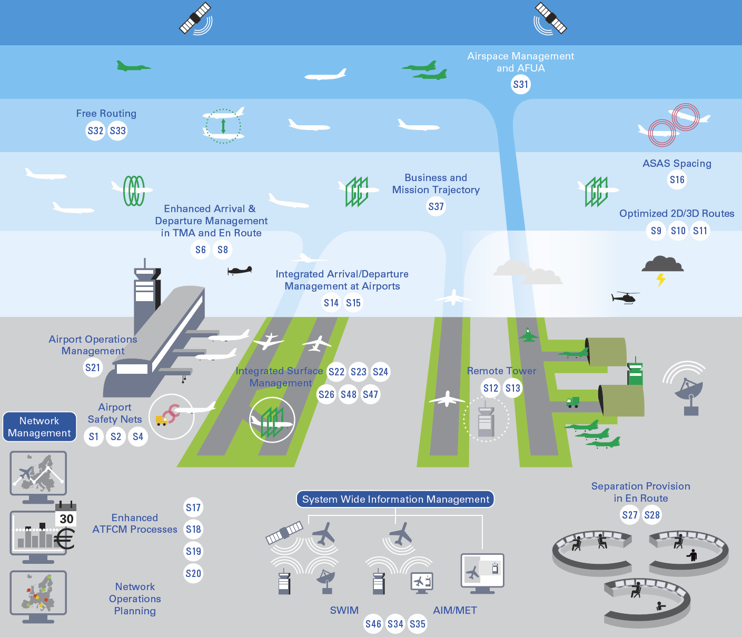
Single European Sky ATM Research Programme
SESAR solutions at current release 5
Moving from airspace to 4D trajectory management
  S32 Free Route through the use of Direct Routing
  S33 Free Route through Free Routing (cruise/vertical)
  S37 Extended Flights Plan
Airport Integration & Throughput
  S1 Runway Status Light
  S2 Airport Safety Nets for controllers …
  S4 Enhanced Traffic Situational Awareness …
  S12 Single Remote Tower operations ..
  S13 Remotely-Provided Air Traffic Service …
  S22 Automated Assistance to Controller …
Network Collaborative Management
  S17 Advanced Short ATFCM Measures …
  S18 Calculated Take-Off Time (CTOT) …
  S19 Automated support for Traffic …
  S20 Collaborative NOP …
  S31 Variable profile military reserved …
SWIM
  S34 Digital Integrated Briefing
  S35 MET Information Exchange
  S46 Initial SWIM
[https://www.sesarju.eu/newsroom/brochures-publications/release-5, https://www.atmmasterplan.eu/data/sesar_solutions]
Notes:
Check
SESAR_Solutions_Catalogue_2019_web.pdf
SESAR_Release_issue_5_web.pdf

Slide 24
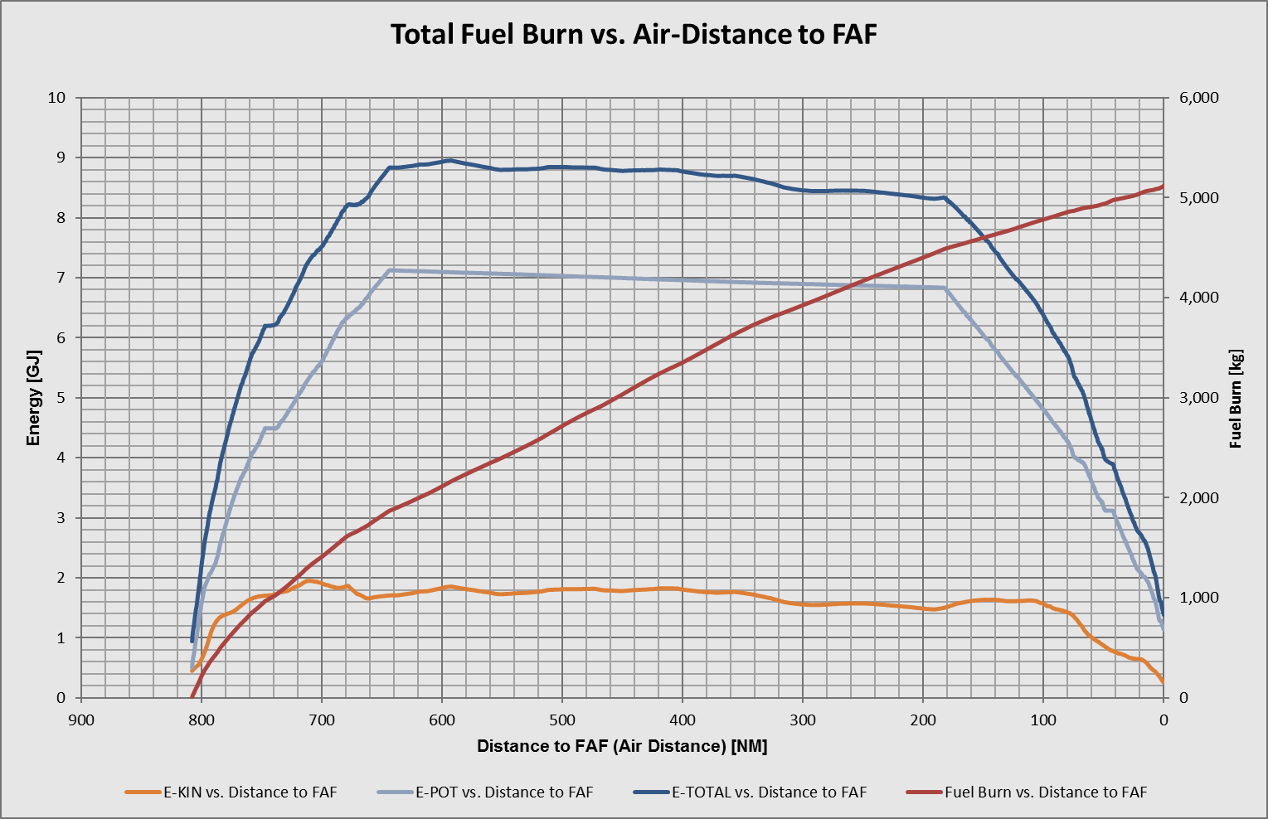


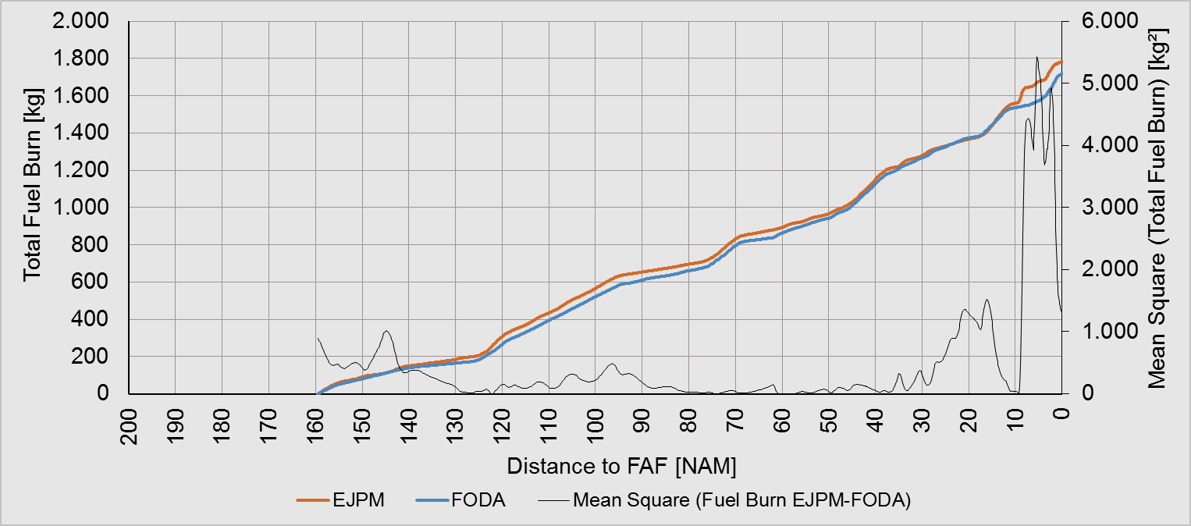
Benchmarking SESAR Functions: CDO, CCO, FRA
ETAS – Enhanced Trajectory Assessment
National working group „Optimised Flying Group“
  5 airlines
  1 ANSP (DFS)
ETAS-powered server application
  Radar tracks (FANOMOS, STANLY Track)
  Mass estimation (DB-backed, handbook-based)
  Aerodynamic work (own APM or BADA 4)
  Energy household (yields thrust required)
  Fuel flow (own APM or BADA 4)
  Gaseous emissions (ICAO Emission DB)
PROCESSING ORDER
Fricke et al, GfL Product

Slide 25
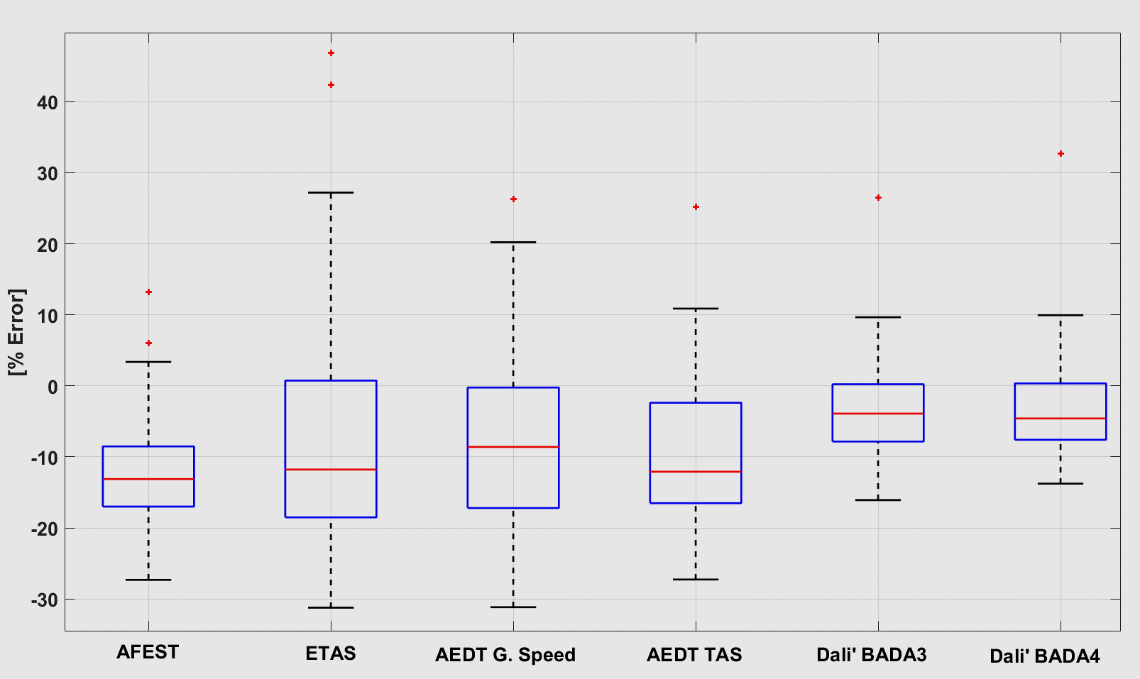
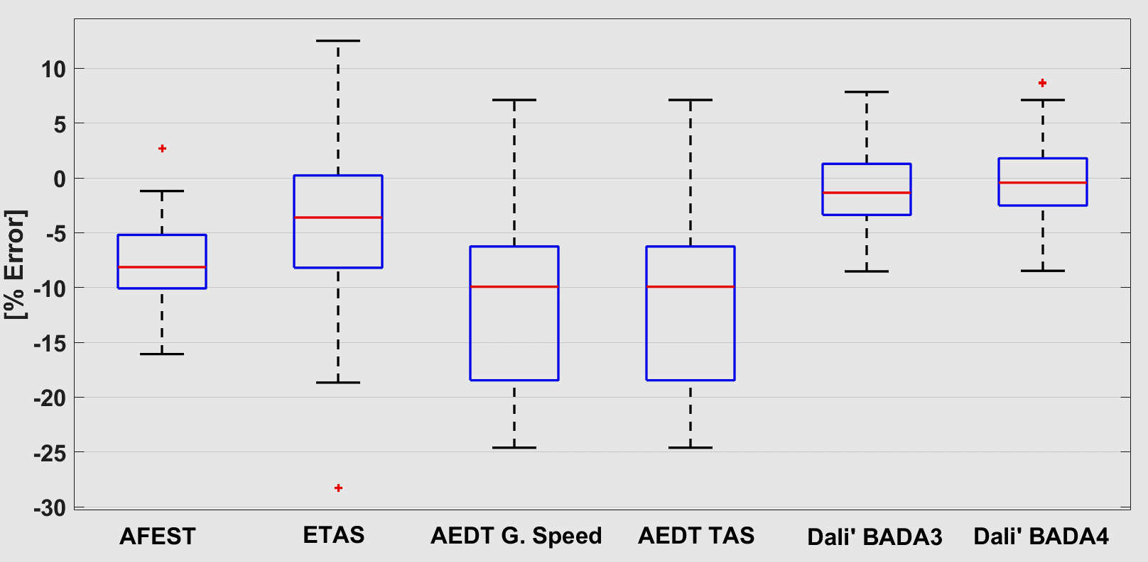
Global Efficiency System Performance Comparison
ETAS, FAA (AFEST, AEDT), AS Australia (Dali´)
Fuel Error
Model predictions with unknown A/C mass as 1st sensitive variable:
    linear ⇨ potential and kinetic energy
    quadratic ⇨ drag coefficient (via lift)
2nd sensitive variable: jitters in position estimation
    1st differential ⇨ ground speed ⇨ … ⇨ drag force
    2nd differential ⇨ acceleration ⇨ kinetic energy rate
3rd sensitive variable: MET data
    ground speed ⇨ air speed conversion
    pressure altitude ⇨ geo(potential) altitude conversion‘
Mass Error
ANSP has so far only limited knowledge about 4D BT
intent both due to limited system capability and lack of data
Fricke et al, ATM Seminar 2017, Seattle

Slide 26
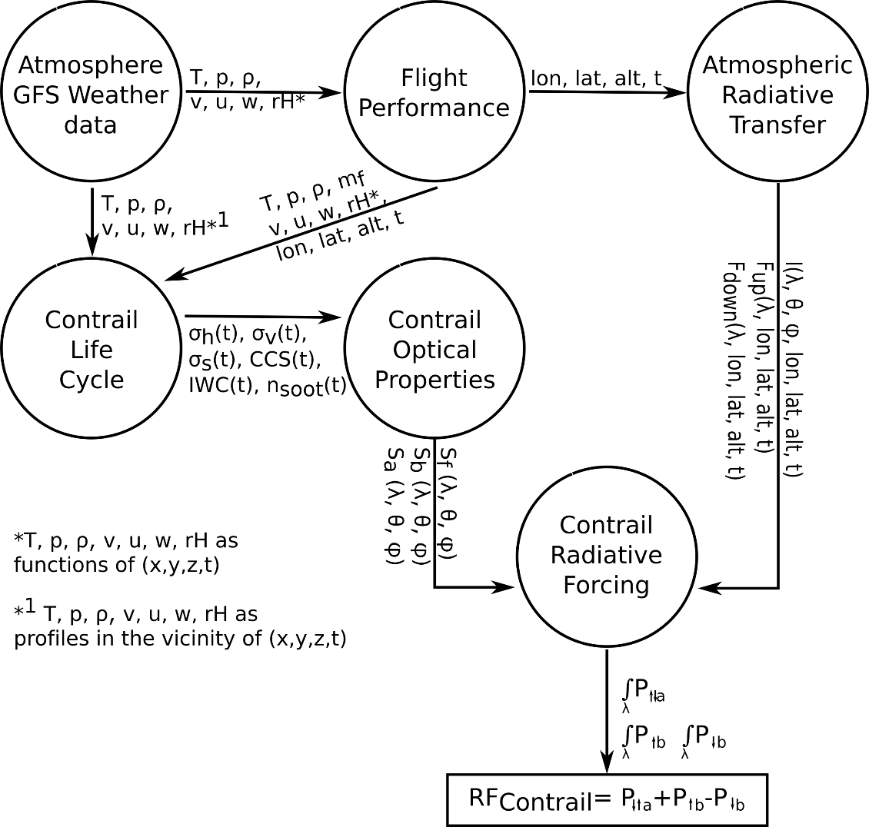
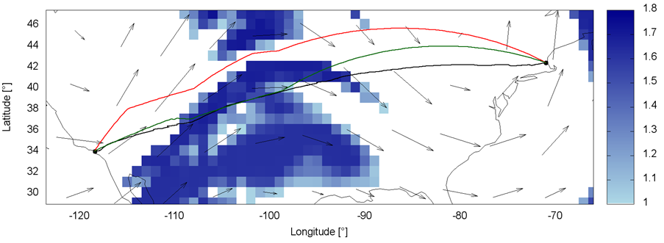
Ongoing Research on Multi-Criteria Trajectory Optimization -
Distinct Ecological Targets
Aim: Ready for (In-fligth) Optimization with highly dynamic and uncertain environmental data
Acts as stochastic optimization to cope with uncertain weather conditions and its evolution
ANSP knowledge about 4D BT intents relies on robust weather models and reliable data
Workflow of multi-criteria contrail assessment
J. Rosenow, H. Fricke, to be presented at ATM Seminar 2019
Trajectory optimization in a contrail sensitive area (blue)

Slide 27
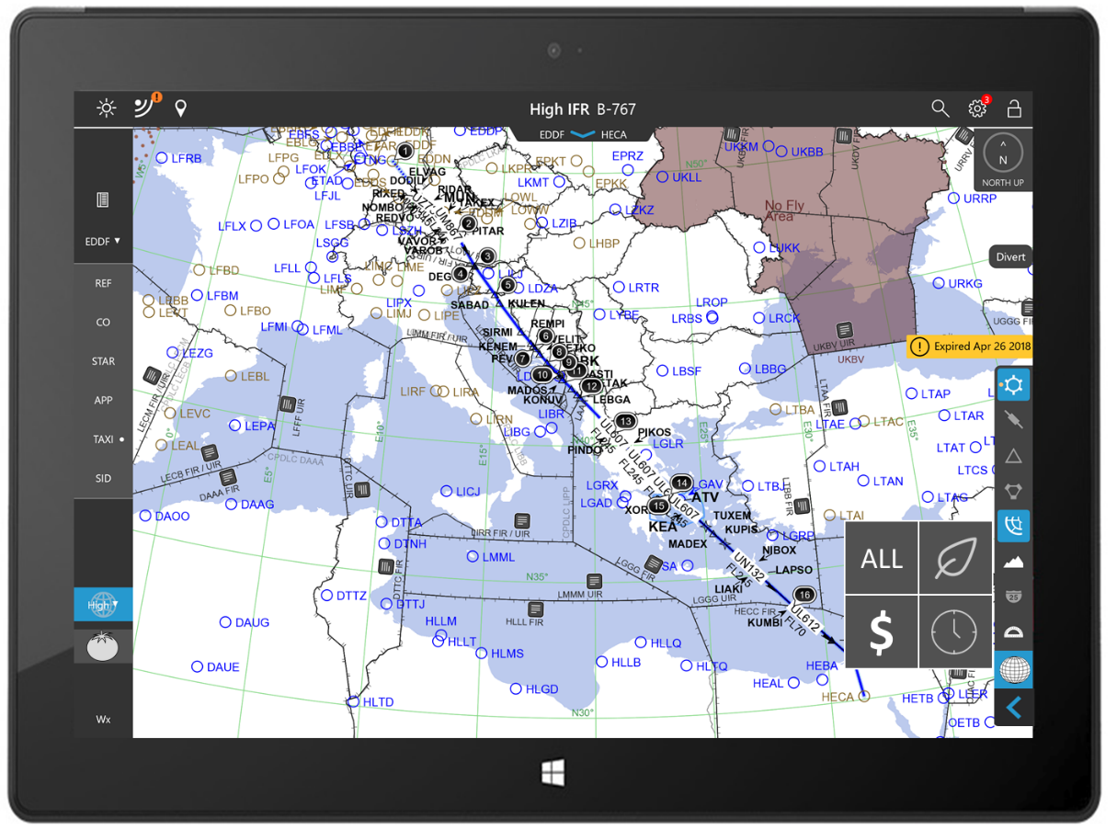
Validating Air Ground Negotiation of Optimized Trajectories (1) -
From Flight Simulator to Real Flight Testing
Display Current Trajectory -
multi-criteria objective optimization
ProfiFuel LUFO Project - EFB Design Concept
TU Dresden, Boeing/Jeppesen, GfL
Notes:
Tu – Pakete, alle zeigen und markieren

Slide 28
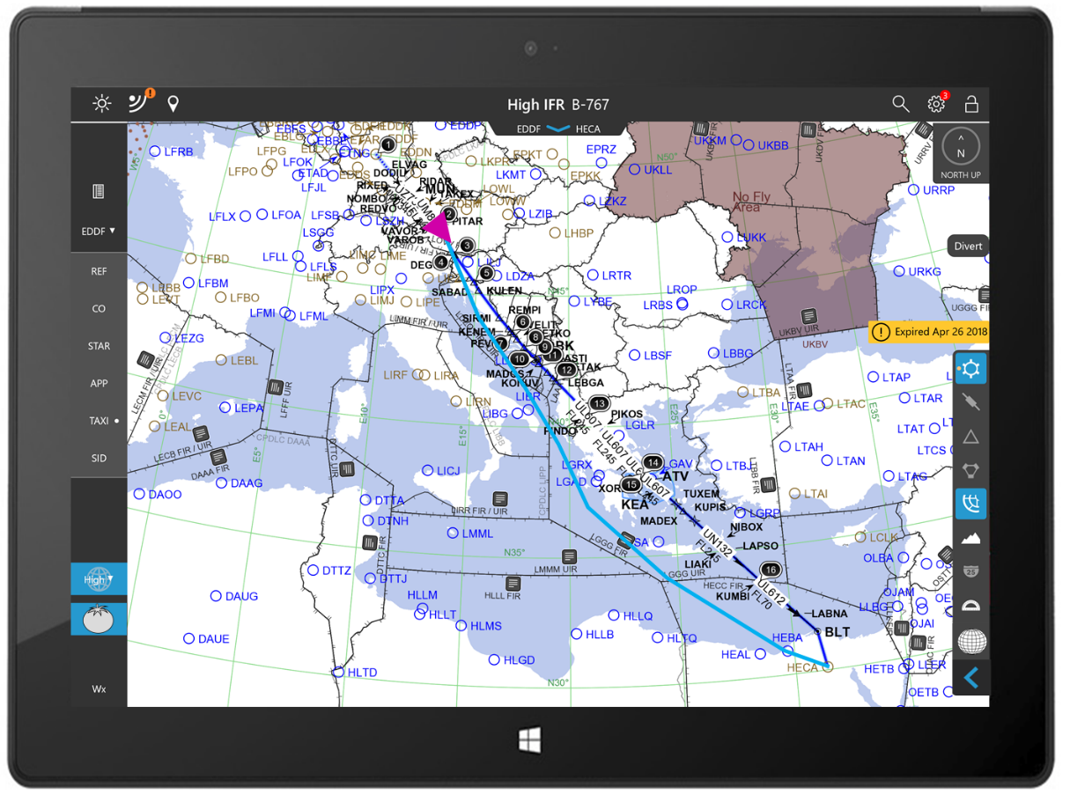
Validating Air Ground Negotiation of Optimized Trajectories (2) -
From Flight Simulator to Real Flight Testing
Display Optimized Trajectory as
Temporary Flightplan
ProfiFuel LUFO Project - EFB Design Concept
TU Dresden, Boeing/Jeppesen, GfL
Notes:
Tu – Pakete, alle zeigen und markieren

Slide 29
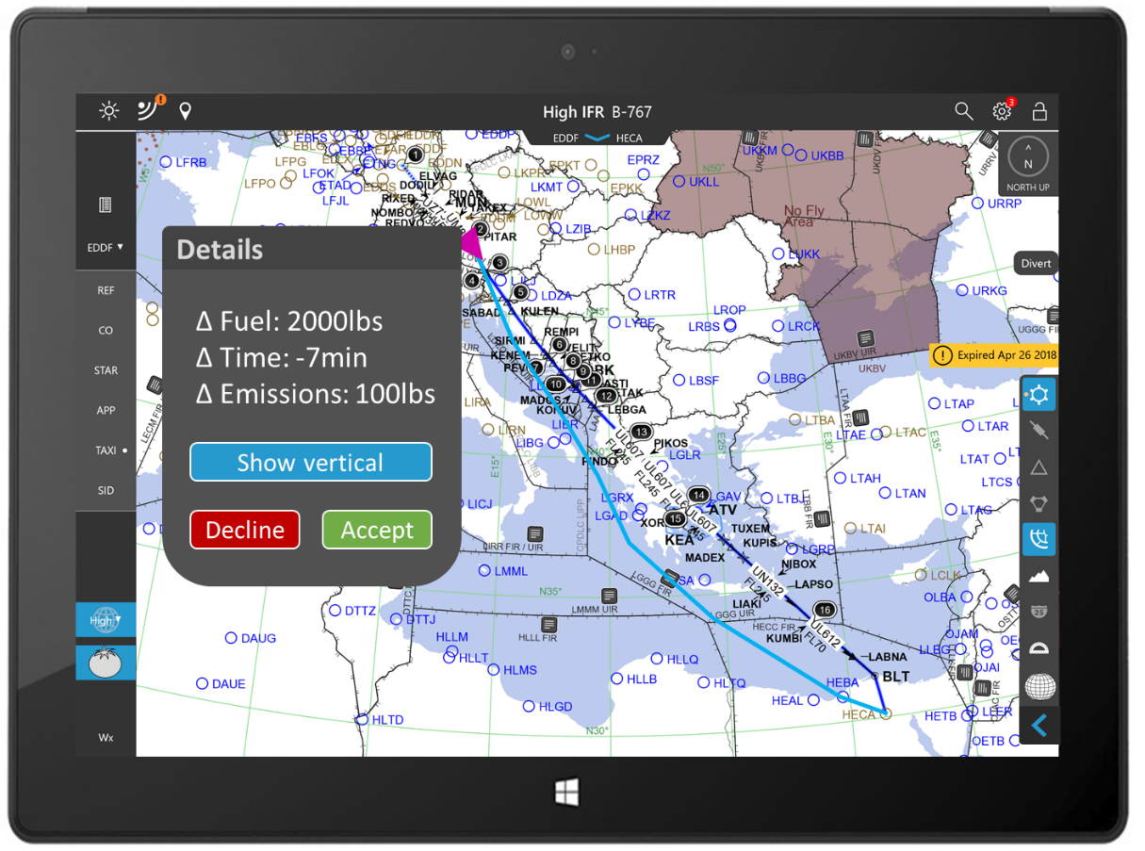
Validating Air Ground Negotiation of Optimized Trajectories (3) -
From Flight Simulator to Real Flight Testing
Display Optimized Trajectory
Efficiency Gain
Will be implemented in the Boeing ECO Demonstrator
in III/2019
ProfiFuel LUFO Project - EFB Design Concept
TU Dresden, Boeing/Jeppesen, GfL
Notes:
Tu – Pakete, alle zeigen und markieren

Slide 30
Agenda
The Rationale of Fragmentation
Current Performance according to PRR
Types of fragmentation – Challenges from
the flow – 4D Business Trajectories
Dynamically Improved Airspace Design
Expectations for the Workshop
Airspace capacity in an European optimized air traffic scenario (8,800 flights between 12 a.m. and 1 p.m.)
Source: J. Rosenow, H. Fricke, T. Luchkova and M. Schultz: Impact of optimised trajectories on air traffic flow management, The Aeronautical Journal, 2019

Slide 31
Spatial fragmentation
Sector adaptation – How to improve?
From 1st Interim Conclusion: Fragmentation is a must
From 2nd Interim Conclusion: Fragmentation should adopt since demand is volatile and technology exceling
Obvious Strategy: Sector layout should follow “flow”
(demand based throughput)
Sectors would consequently have to become more dynamic
Flow oriented Sector Design can be mathematically solved
But: To what extent can ATCOs follow dynamic structures and thus responsibilities over flights and at what productivity level?

Slide 32
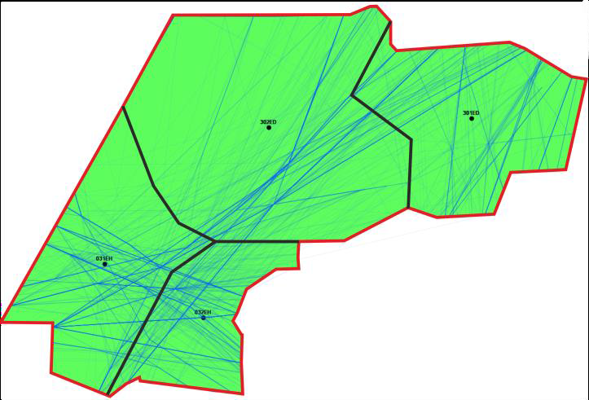
Flow oriented airspace structuring balancing controller task load – an example
Traffic sample with actual sector structure
(Maastricht/Amsterdam airspace - EDYYDUTA)
Performance targets
Flexible use of airspace usages
Balancing of traffic complexity and traffic density
Harmonization of controller tas kload
Flight-aircraft centric approach allows transition from todays structural airspace designs
New paradigm
Control structure follows traffic flow
Three-step, scalable approach:
Fuzzy Clustering – identify traffic hot spots
Voronoi-diagrams – initial airspace structure
Evolutionary Algorithms – optimize airspace structure
I. Gerdes et al. (2018). Dynamic airspace sectorisation for flight-centric operations. Transportation Research Part C: Emerging Technologies 95:460-480

Slide 33
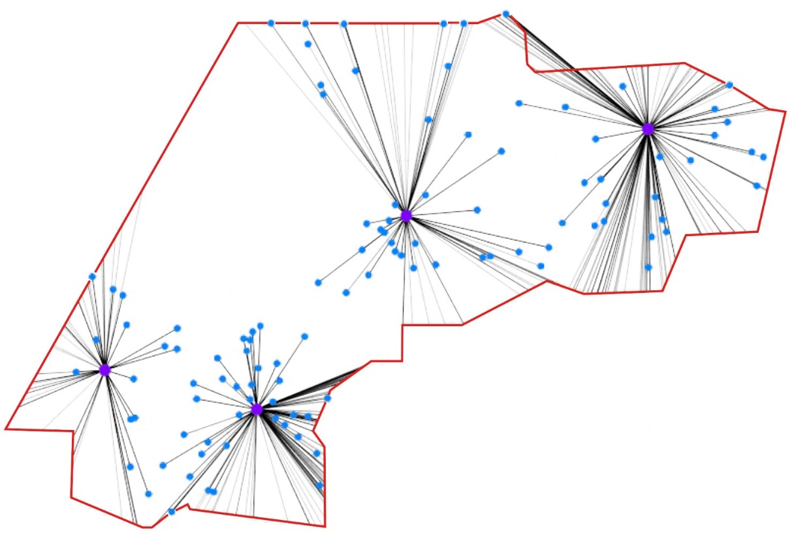
Flow oriented airspace structuring balancing controller task load – an example (2)
Traffic sample with actucal sector structure
(Maastricht/Amsterdam airspace - EDYYDUTA)
Calculation of cluster centers using fuzzy clustering to adapt to noisy, aircraft position data (trajectories)
I. Gerdes et al. (2018). Dynamic airspace sectorisation for flight-centric operations. Transportation Research Part C: Emerging Technologies 95:460-480

Slide 34

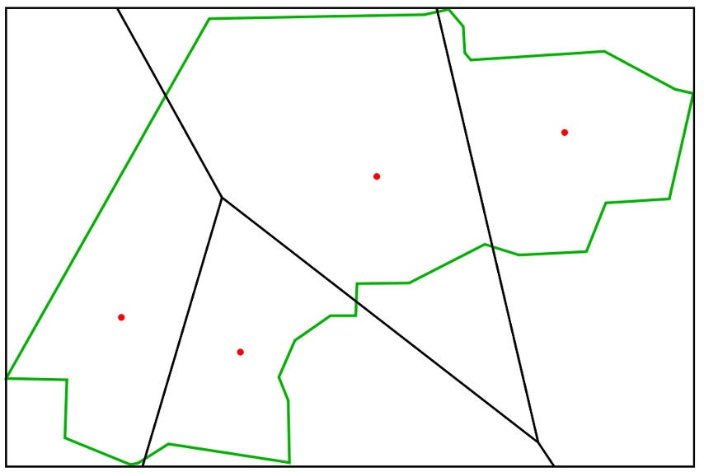
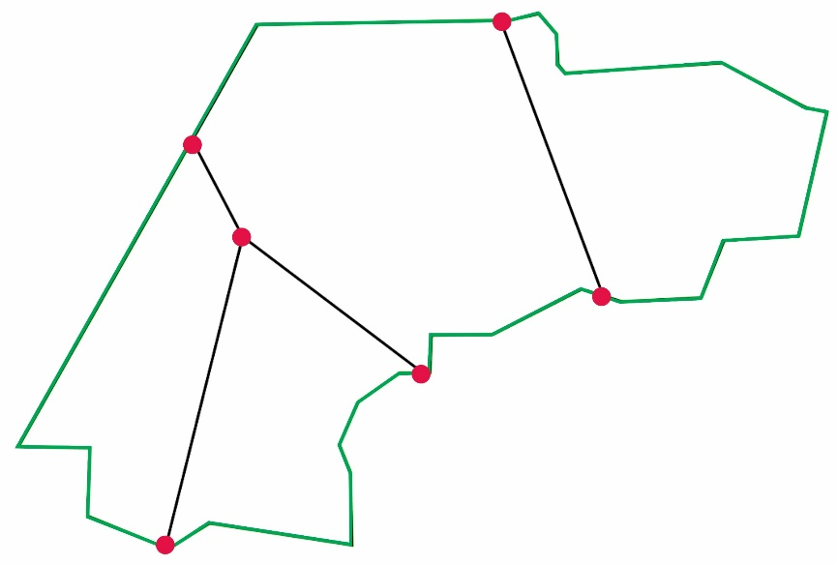
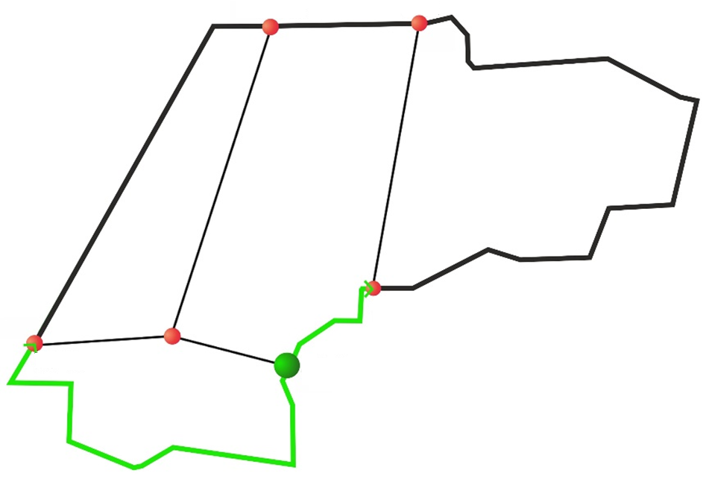
Flow oriented airspace structuring balancing controller task load – an example (3)
Three steps to derive flow centric airspace structures
create Voronoi structure
traffic centers (#movements)
and inside the structure
define outer boundary
(handling non-convex borders)
optimize inside & along boundary
(averaging controller task load)
I. Gerdes et al. (2018). Dynamic airspace sectorisation for flight-centric operations. Transportation Research Part C: Emerging Technologies 95:460-480

Slide 35
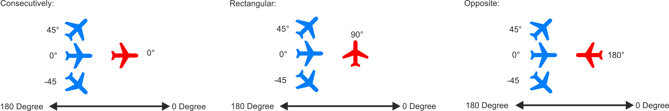
Efficient traffic handling controller taskload metrics
Calculation of task load as primary objective function
Different types of conflict demands for different times to solve
Controller | Main Type | Sub Type | Task-Name | Time [s] | Per Seconds | Group
Radar | Sector_Entry | CHANGE SECTOR IN CRUISE FROM SAME ACC | Initial Call | 11 | - | Radio Telephony
 |  |  | Initial Monitoring | 14 | - | Monitoring
 |  |  | Receipt Flight Strip | 3 | - | Coordination
 |  | CHANGE SECTOR IN CRUISE FROM DIFF ACC | Initial Call | 15 | - | Radio Telephony
 |  |  | Initial Monitoring | 14 | - | Monitoring
 |  |  | Receipt Flight Strip | 3 | - | Coordination
 | Conflict | CONFLICT TYPE 1 | Conflict Detection | 17 | - | Conflict Search
 |  |  | Conflict Resolution | 60 | - | Conflict Resolution
 | Recurring-Monitoring | RECURRING MONITORING | Monitoring | 5 | 120 | Monitoring
[…]
I. Gerdes et al. (2016). Dynamic airspace sectorization using controller task load. 6th Eurocontrol SESAR Innovation Days
Notes:
system of 55 tasks for radar, planning, arrival, airport, tower and apron controller with 129 sub-tasks
based on data for necessary task times used by German ANSP (DFS) and EUROCONTROL

Slide 36
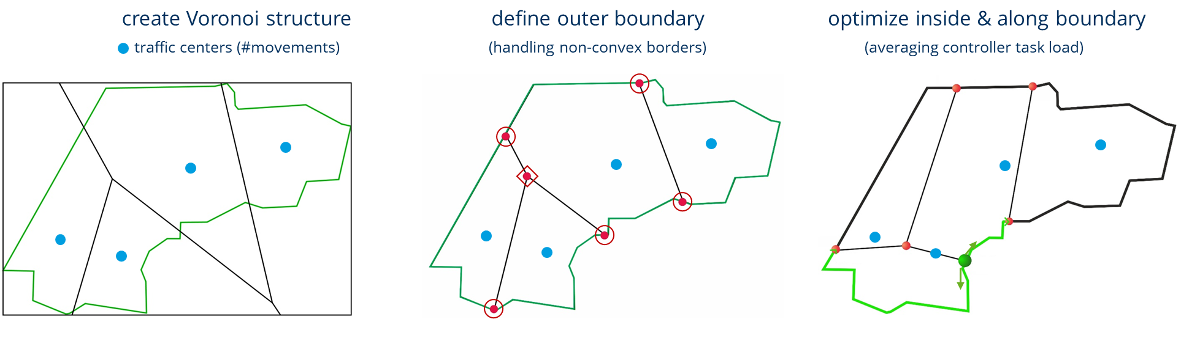
Flow oriented airspace structuring
The Control Loop design – pending research
Demand
Deviation from Forecast: Plan / Re-plan?
Flow / Demand Update
I. Gerdes et al. (2018). Dynamic airspace sectorisation for flight-centric operations. Transportation Research Part C: Emerging Technologies 95:460-480

Slide 37
Agenda
The Rationale of Fragmentation
Current Performance according to PRR
Types of fragmentation – Challenges from
the flow – 4D Business Trajectories
Dynamically Improved Airspace Design
Expectations for the Workshop
Airspace capacity in an European optimized air traffic scenario (8800 flight between 12 a.m. and 1 p.m.)
Source: J. Rosenow, H. Fricke, T. Luchkova and M. Schultz: Impact of optimised trajectories on air traffic flow management, The Aeronautical Journal, 2019

Slide 38
(2) Evaluation metrics research questions
77 Inter-FAB-coordination related projects dealing with performance improvement in FABs:
To increase the safety level (14)
To increase capacity (15)
To support environmental changes (16)
To increase efficiency (6)
To develop performance metrics (22)

Slide 39
(2) Evaluation metrics research debates on ….
Fragmentation
Metrics of Efficiency
  Efficiency benefit of economies of scale for small ANSPs
  Overview and definition of divergence in performance metrics
Impact of Fragmentation on delay and congestion
Impact of Fragmentation on route charges
Impact of Fragmentation on Hungarian Military Requirements
Impact of value-based-policies-making on Fragmentation
Performance improvement and measurement in FABs: Summary of recent findings
Cost-effectiveness
Notes:
value-based-policies-making means: values for environmental issues, capacitiy, liberalization (contradicts with state prerogatives), Competetition contradicts with monopolistic structures
Gini Coefficient: distribution of the controlled flight hours

Slide 40
Looking forward to 1,5 days of good debates leading to further enhancements of the
European Airspace
Thank you !
Contact
Dr. Hartmut Fricke
Technische Universität Dresden
Chair of Aviation And Logistics
hartmut.fricke@tu-dresden.de

Slide 41
Impact of Fragmentation on ATM System Performance
Prof. Dr.-Ing. habil. Hartmut Fricke
Institute of Logistics and Aviation
Budapest, May 2019

Slide 42
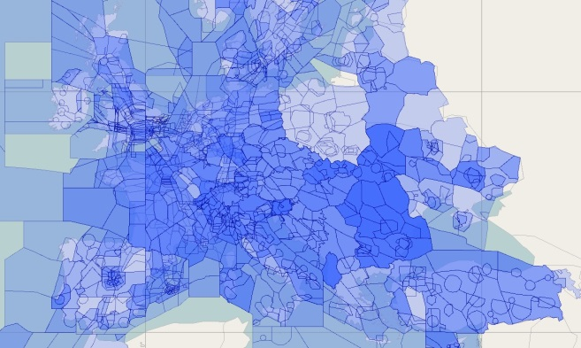
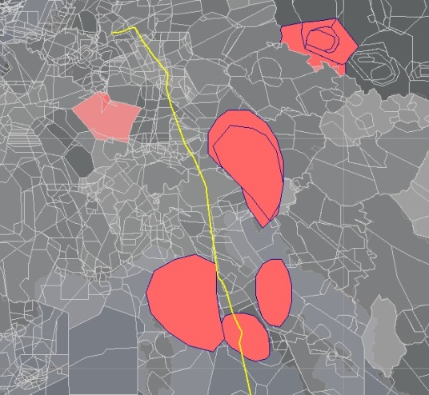
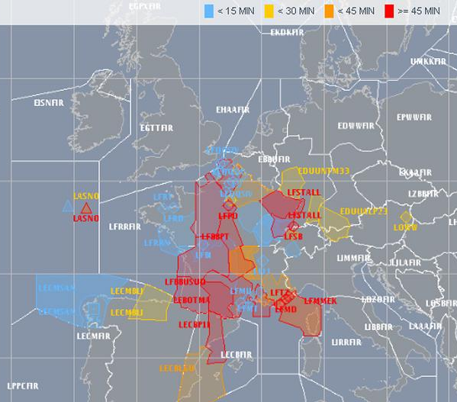
Airspace structure and operations
Europe consists of high number of airspace sectors, controlled by different entities, with different strategies to efficiently handle daily operations.
.. including handling of several sources of uncertainty (known knowns) , disturbances (known unknowns) and disruption (contingency)
Notes:
Europe constists of high number of airspace sectors, controlled by different entities, with different strategies to efficiently handle daily operations

Slide 43
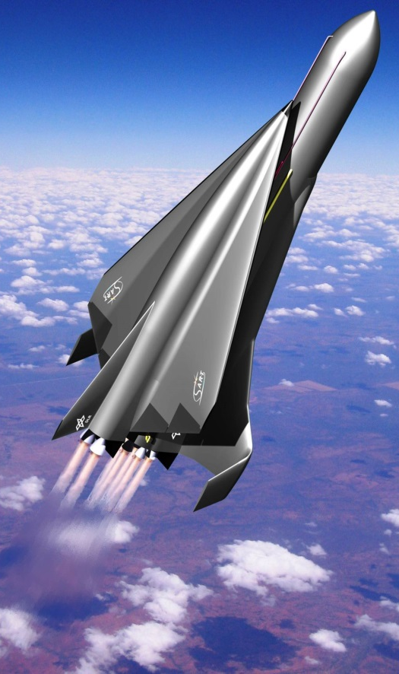
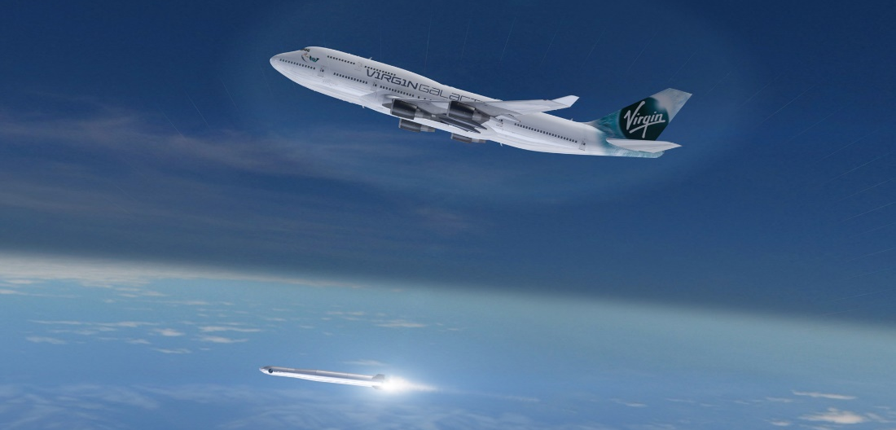
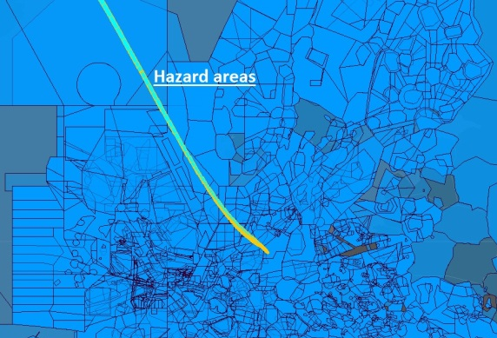
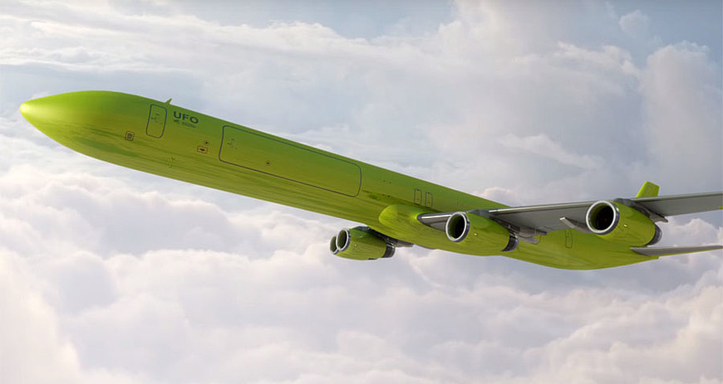
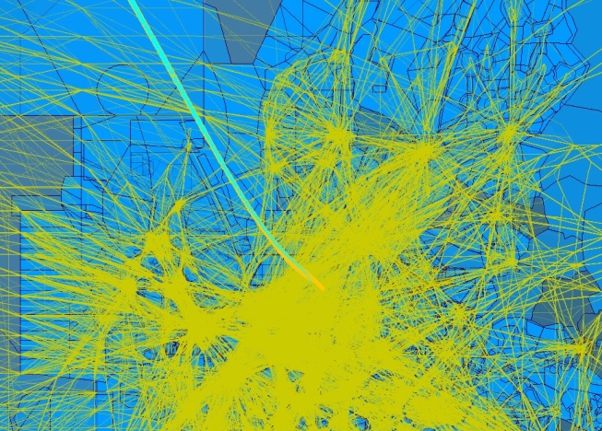
New entrants operations in European airspace
Notes:
https://www.helmholtz.de/luftfahrt_raumfahrt_und_verkehr/unbemannte-transportflugzeuge-im-test/
https://www.dlr.de/irs/desktopdefault.aspx/tabid-11303/#gallery/26919
https://www.space.com/16532-virgin-galactic-launcherone-rocket-images/2.html

Slide 44
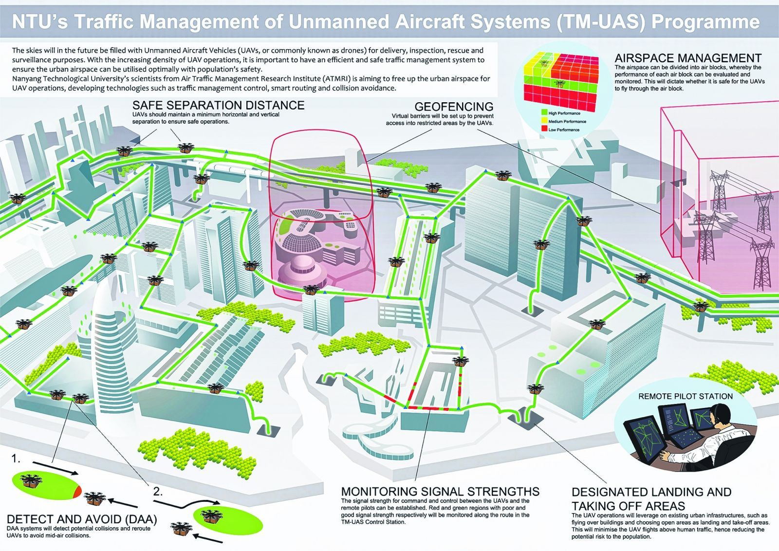

Local airspaces unmanned aircraft systems in urban areas
Main features of drone operations:
Dynamic airspace planning,
UAS Highways for inter-zone UAV operations
Flow oriented airspace structuring
Flow oriented airspace structuring
[Kin Huat Low (2017). Framework for urban Traffic Management of Unmanned Aircraft System (uTM-UAS)]

Slide 45
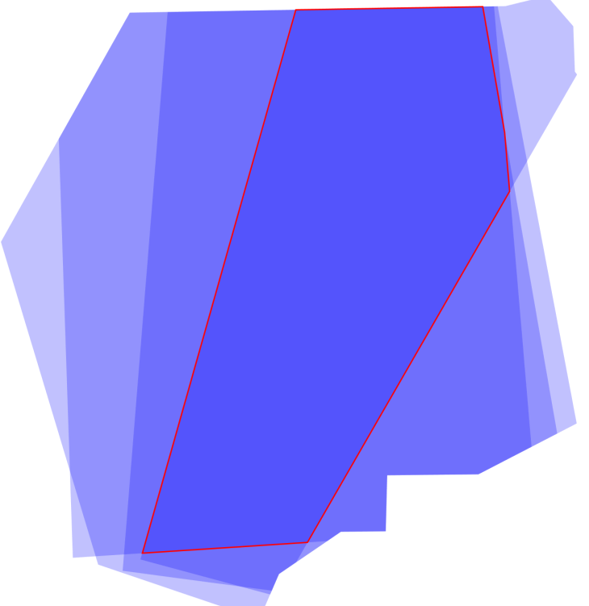
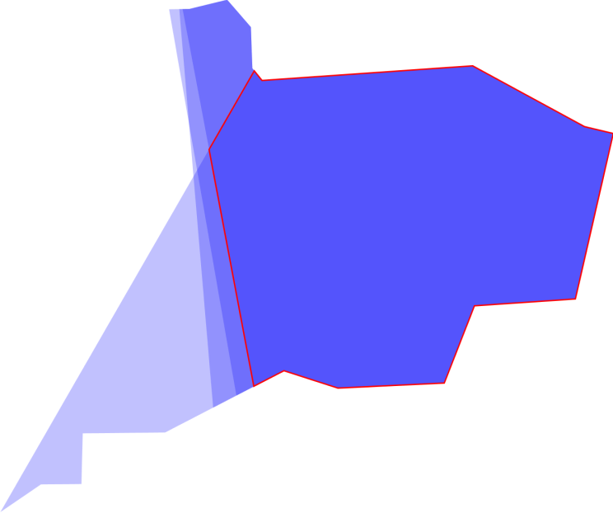
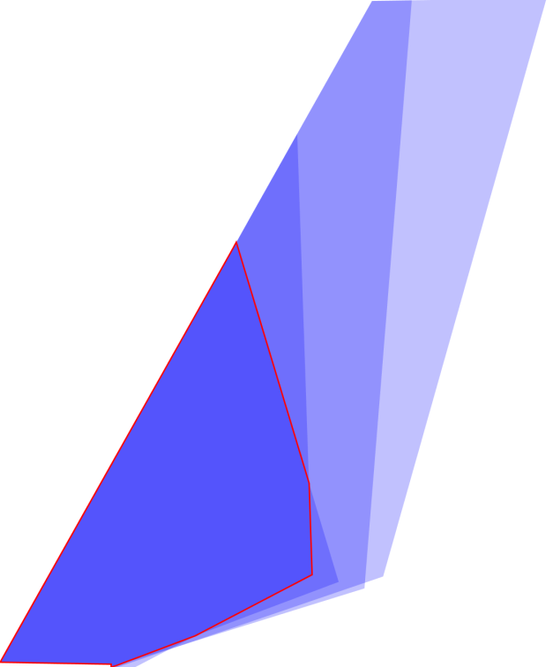
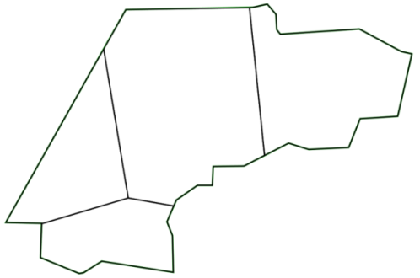
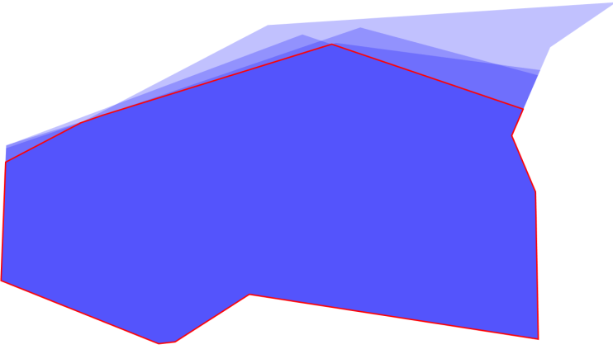
Dynamic airspace sectorization (core areas) adapt to traffic changes balancing controller workload
Maastricht/Amsterdam
Airspace (EDYYDUTA)

